Slide 1
Inventory Change R32 Analysis 2015.01.30

Slide 2
Overview
Inventory Snapshots
Goods Issue to Customers
Production Credits
Imports
Other Inventory Change Not Currently Reported
Returns
Stock Transfers
Intercompany Transfers
Inventory Gain / Loss

Slide 3
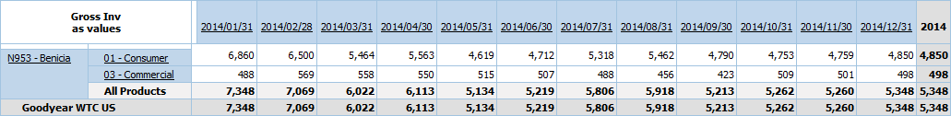

Inventory Snapshots
NAT Imports Cube – Sources Data from YY07
N953 – Benicia (COWD Location)
Has appeared as part of this dataset each month since Feb. 2013
Custom subset ‘Excluding COWD’ has been created and is the current default for the cube

Slide 4

Goods Issue to Customers
R32Source: Consumer / Commercial Daily Shipment Report
SAP Delivery Documents
MM Source: Material Movement Documents w/ Movement Types:
601, 602, 983, 984, 985, 986, 987, 988, 989, 990, 991, 992, 993 & 994
Only includes shipments that reference sales orders (ignores FOC)
Ex. Consumer report excludes Sales Org N305 / Race
Snapshot timing also has some effect on the values YY07 picks up
‘Wall Clock’ vs. ‘Official’ time
Counted Current, Posted Other
Added
Inventory was physically present for YY07, but Reported against another month
Posted Current, Counted Other
Inverted
Inventory was physically counted the month before or after but Reported in the current month

Slide 5

Production Credits
R32 Source: Production Plans & Credits Cube
MM Source: Material Movement Documents w/ Movement Types:
909, 910, 911
The Production Plans & Credits Cube matches Material Movements by Post Date to the unit
Some minor exceptions, but currently less than 0.01% in a given month
Snapshot Timing is the biggest potential for R32 v. YY07 discrepancies
Counted Current, Posted Other
Added
Inventory was physically present for YY07, but Reported against another month
Posted Current, Counted Other
Inverted
Inventory was physically counted the month before or after but Reported in the current month

Slide 6

Imports
R32 Source: Current Month Imports – Country Sectioning Report
Based on Purchase Order History & ASNs for specific vendors
MM Sources:
Material Movement Documents w/ Movement Types:
101, 102, 561, 562, Y17
PO Type = NB and PO Item’s Confirmation Control ID Not Z004 or Z005
Advance Shipment Notifications:
Delivery Category = 7 and Delivery Type = EL
And PO Type = NB and PO Item Confirmation Control is Z004 or Z005
Reported by Delivery Doc’s Original Doc Date
Cancelled Advance Shipment Notifications:
The LPC deletes ASNs which have been found to be created in error
As soon as an ASN is created it is counted as In Transit inventory by YY07, when deleted it falls off
To find these records we have to search the Change Doc Item table for documents deleted from SAP table LIPS
There is no current record of these documents in AP0
Issues arise when ASNs are created in prior months, but cancelled in the current month because we cannot account for the loss of Gross Inventory

Slide 7
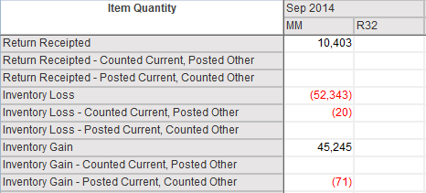
Other Inventory Changes
R32 does not currently report
MM Sources:
Returns Receipted: Material Movement Types 978, 979
Inventory Loss / Gain: Movement Types 551, 552, 553, 554, 851, 852 & Numerous 900’s
Stock Transfer Orders – Domestic & Intercompany
Initial analysis shows there may be some timing issues / imbalances between inbound and outbound document creation
All are relatively small, but help explain a portion of the adjustments line
Stock Transfers should balance out, but it appears that sometimes they don’t
Potentially caused by snapshot timing

Slide 8

Remaining Adjustments
The MM Analysis still shows adjustments are required to balance the monthly number
In general, these adjustments are smaller than the current reporting
Potential causes:
To identify Cancelled ASNs we are relying on EDW change records
EDW generally advises against using change records for reporting
EDW change records aren’t guaranteed to be present or consistent
EDW generally advises against using change records for analysis
Change records were used in this case because no better data source could be identified
Potential issues with ASNs:
We may have more ASN cancellations than reported here
We may have created more ASNs than reported here
YY07’s application logic is complex
There is potential to improve the report logic to increase accuracy
YY07 begins running around midnight and finishes between 1:30 and 4AM
Stock Transfers are actively being created in the YY07 runtime hours
Movements during this time period may cause calculation errors due to inconsistencies

Slide 9
Final Notes
For this analysis, R32 was able to be precisely re-engineered. The comparison values approximate, and are not the same as the published report
Thank you for your time!

